Slide 1


Slide 2
MNIST
The MNIST database (Modified National Institute of Standards and Technology database) is a large collection of handwritten digits. It has a training set of 60,000 examples, and a test set of 10,000 examples.

Slide 3
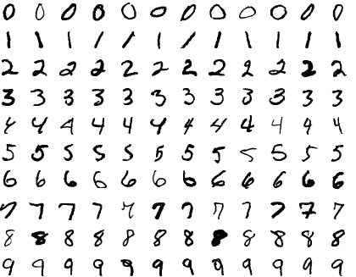
MNIST
https://git-disl.github.io/GTDLBench/datasets/mnist_datasets/

Slide 4

Cross validation

Slide 5
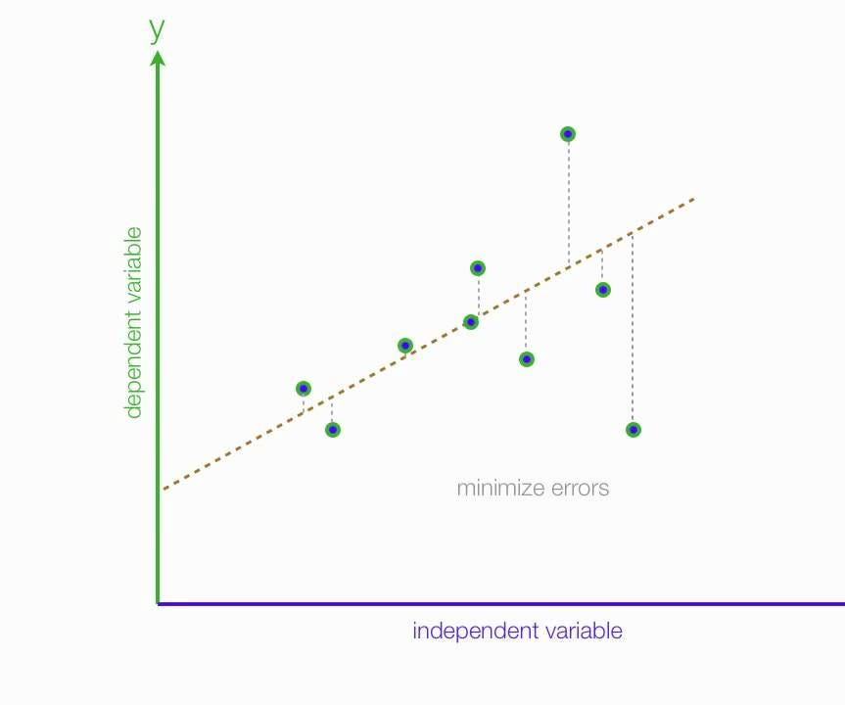
MAE-MSE-RMSE
The objective of Linear Regression is to find a line that minimizes the prediction error of all the data points

Slide 6
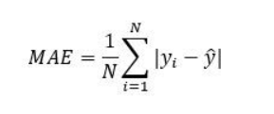
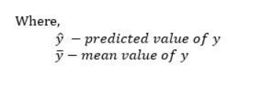
MAE
The Mean absolute error represents the average of the absolute difference between the actual and predicted values in the dataset. It measures the average of the residuals in the dataset

Slide 7
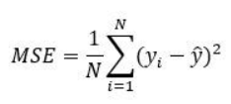
MSE
Mean Squared Error represents the average of the squared difference between the original and predicted values in the data set. It measures the variance of the residuals.

Slide 8
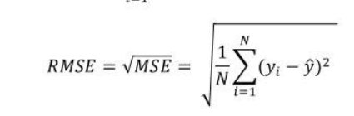
RMSE
is the square root of Mean Squared error. It measures the standard deviation of residuals.

Slide 9
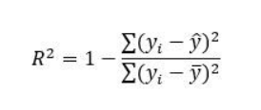
R-Squared
represents the proportion of the variance in the dependent variable which is explained by the linear regression model. It is a scale-free score i.e. irrespective of the values being small or large, the value of R square will be less than one

Slide 10
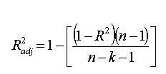
Adjusted R squared
is a modified version of R square, and it is adjusted for the number of independent variables in the model, and it will always be less than or equal to R².In the formula below n is the number of observations in the data and k is the number of the independent variables in the data.

Slide 11
Discuss
Mean Squared Error(MSE) and Root Mean Square Error penalizes the large prediction errors vi-a-vis Mean Absolute Error (MAE). However, RMSE is widely used than MSE to evaluate the performance of the regression model with other random models as it has the same units as the dependent variable (Y-axis).
MSE is a differentiable function that makes it easy to perform mathematical operations in comparison to a non-differentiable function like MAE. Therefore, in many models, RMSE is used as a default metric for calculating Loss Function despite being harder to interpret than MAE.
The lower value of MAE, MSE, and RMSE implies higher accuracy of a regression model. However, a higher value of R square is considered desirable.

Slide 12
Discuss
R Squared & Adjusted R Squared are used for explaining how well the independent variables in the linear regression model explains the variability in the dependent variable. R Squared value always increases with the addition of the independent variables which might lead to the addition of the redundant variables in our model.
Adjusted R squared takes into account the number of predictor variables, and it is used to determine the number of independent variables in our model. The value of Adjusted R squared decreases if the increase in the R square by the additional variable isn’t significant enough.

Slide 13
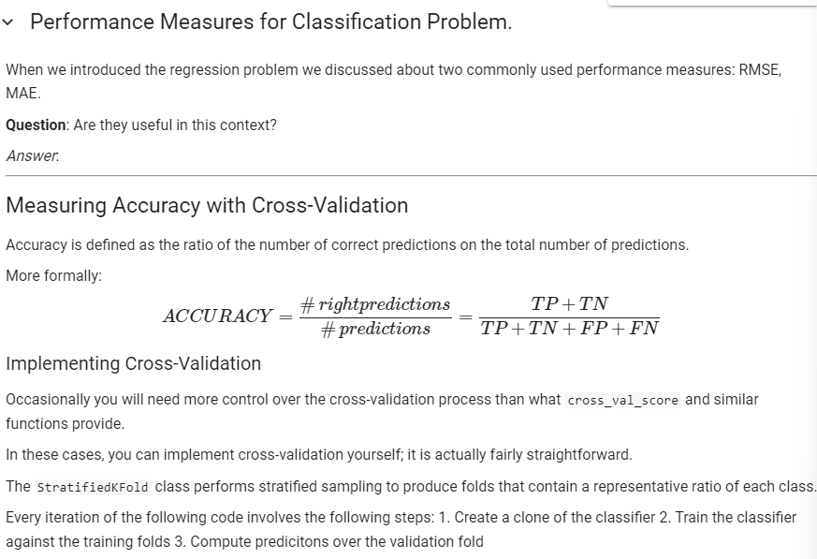
Performance of classification

Slide 14
TP-TN-FP-FN
Since we are dealing with binary classification, we can devise 4 categories:
True Positive - samples predicted as positive that are actually positive (right classification)
True Negative - samples predicted as negative that are actually negative (right classification)
False Positive - samples predicted as positive that are actually negative (wrong classification)
False Negative - samples predicted as negative that are actually positibe( wrong classification

Slide 15
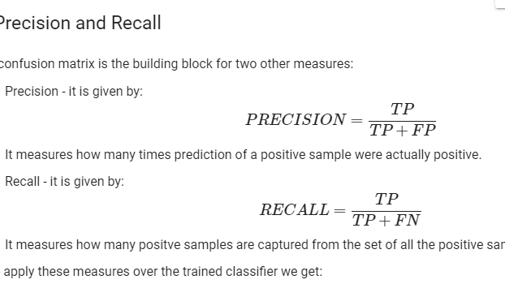

Slide 16
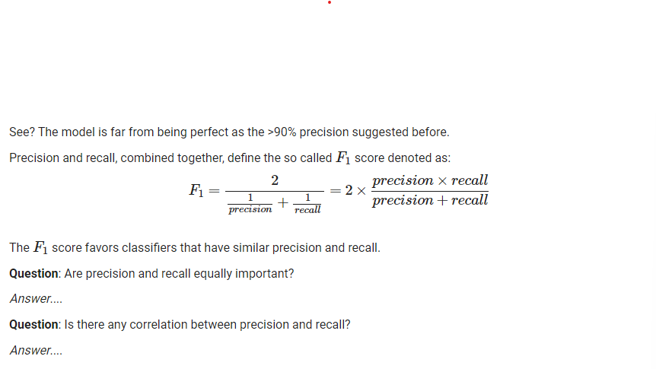
F1-Score

Slide 17
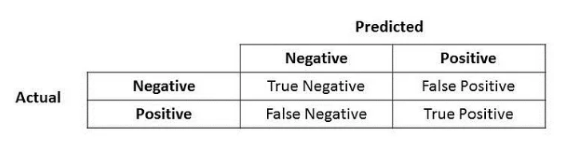

Slide 18
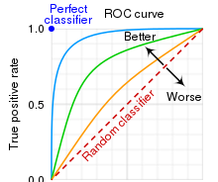
ROC
An ROC curve (receiver operating characteristic curve) is a graph showing the performance of a classification model at all classification thresholds. This curve plots two parameters: True Positive Rate.

Slide 19
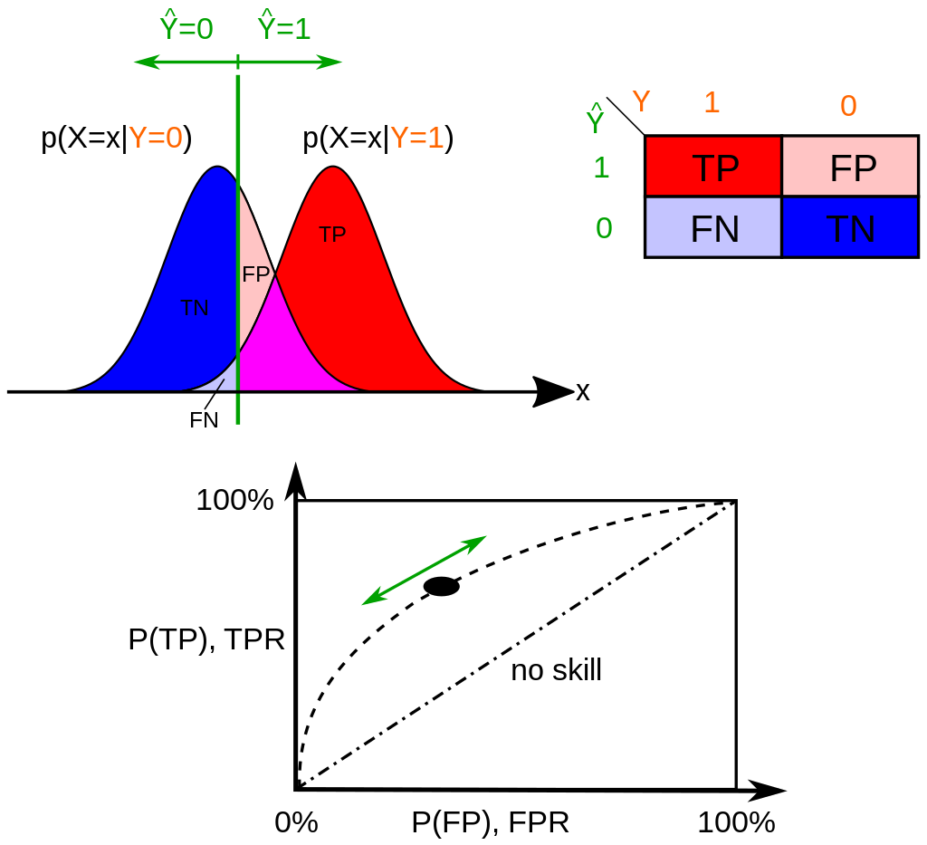

Slide 20
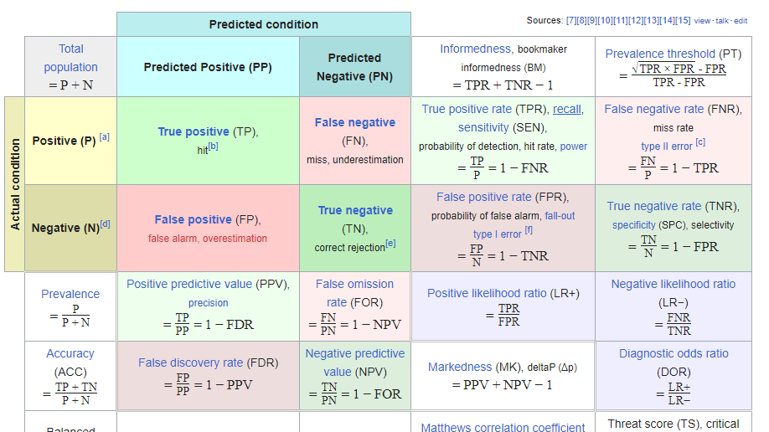

Slide 21
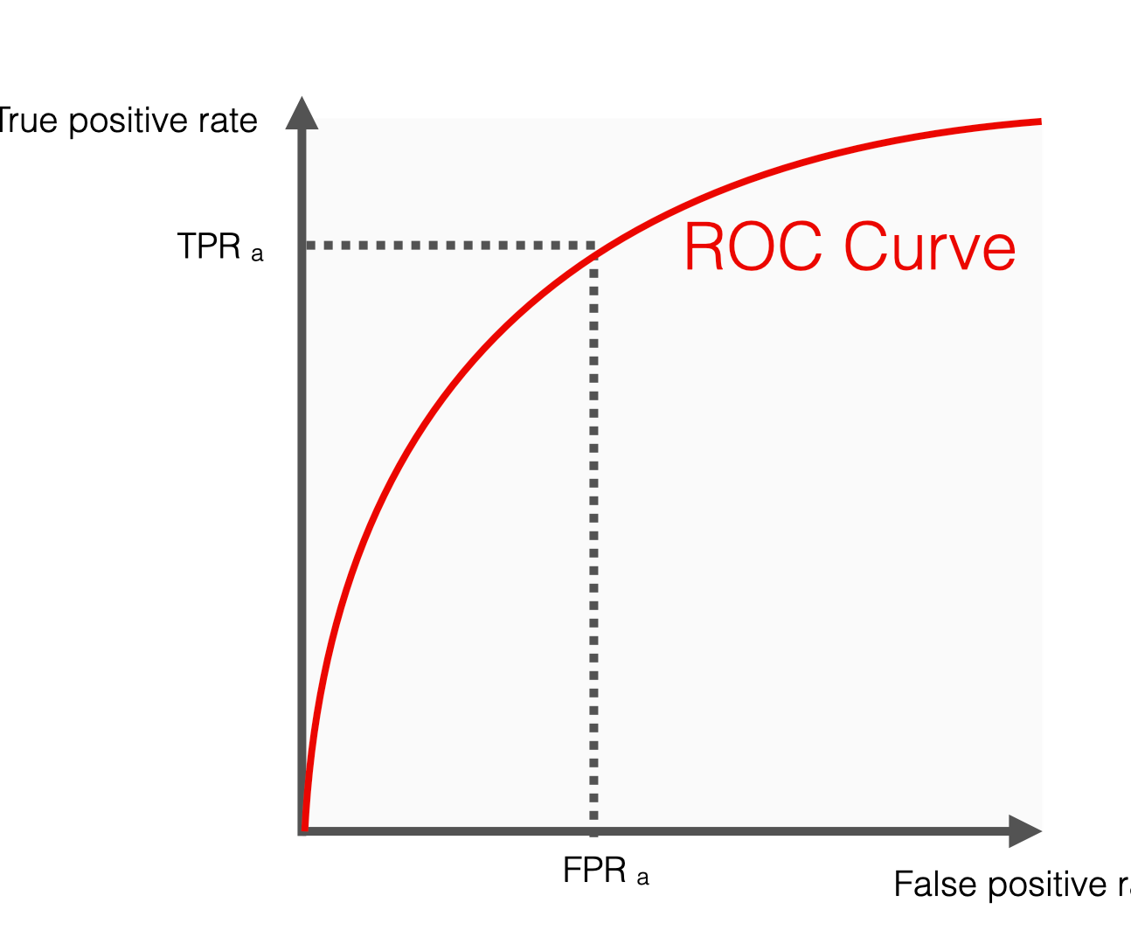
AUC
AUC stands for "Area under the ROC Curve." That is, AUC measures the entire two-dimensional area underneath the entire ROC curve

Slide 22
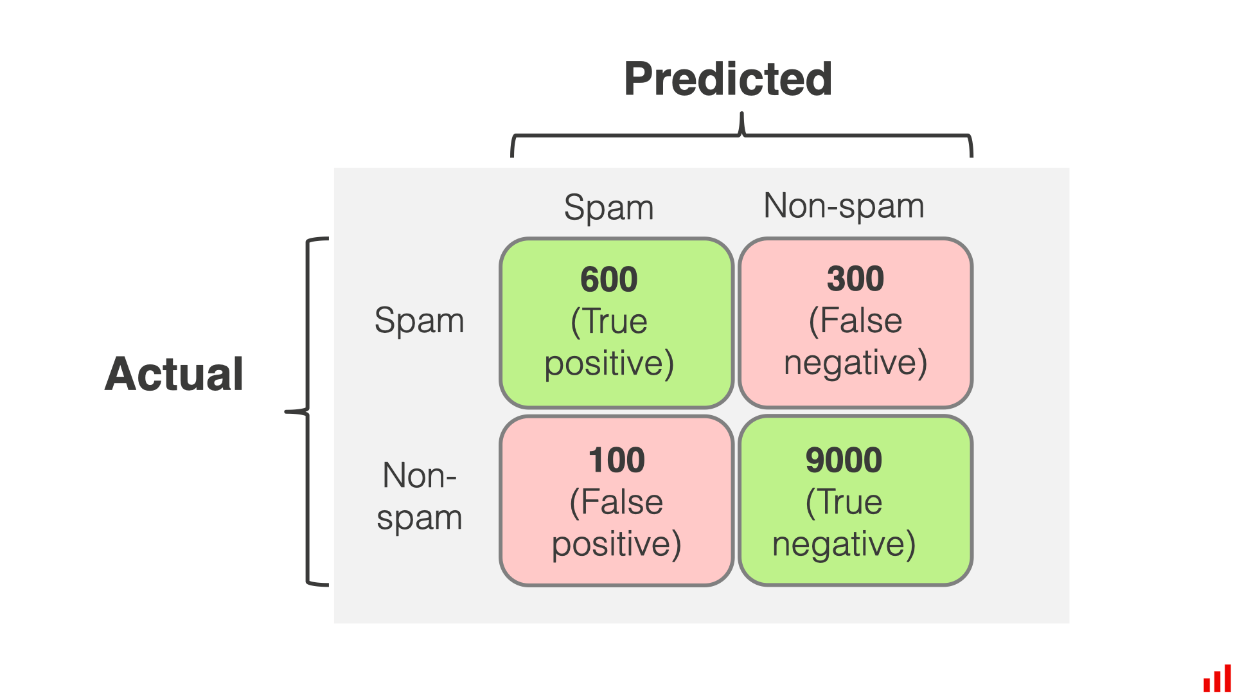

Slide 23
